Slide 1
GlimpseData: Towards Continuous Vision-Based Personal Analytics
Seungyeop Han with
Rajalakshmi Nandakumar, Matthai Philipose, Arvind Krishnamurthy, and David Wetherall
University of Washington
Microsoft

Slide 2
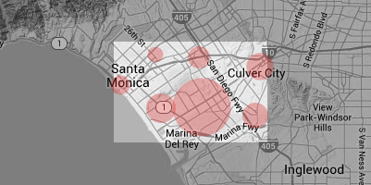
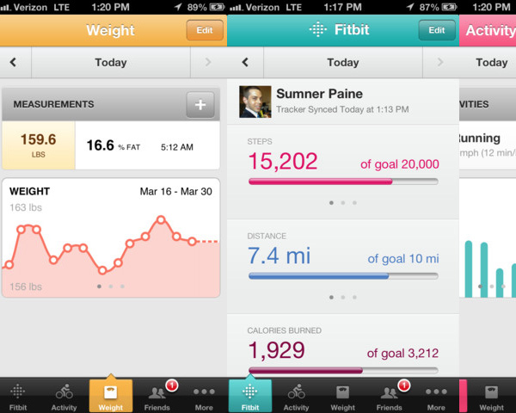
Personal Analytics: Measure, analyze, and share data about life

Slide 3
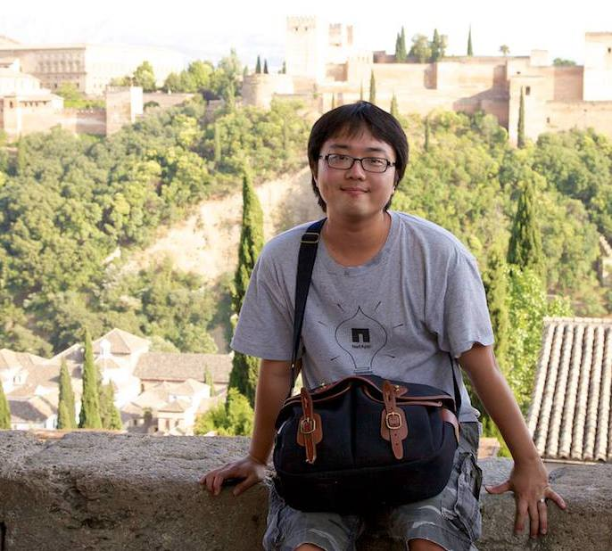
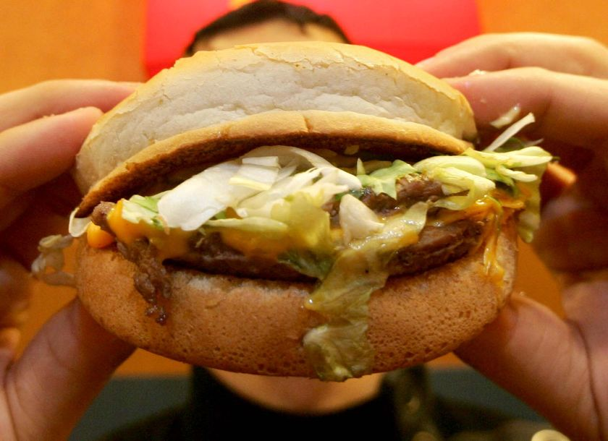
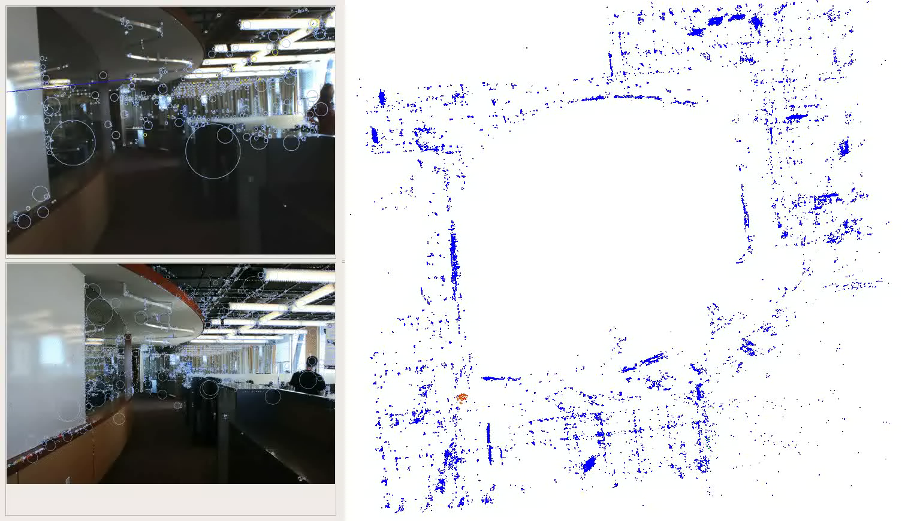
Visual Data adds New Dimensions
Seungyeop
Hamburger
354 cal
Who?
What?
What you have eaten
Calorie counter
Remind medication
…
Where?
Vision-based Localization
Remind visits
Indoor-location based ads
…
Whom you have met today
Remind people’s name
Foster social interaction
Check people’s mood
…

Slide 4
Challenges of Vision-based Analysis
Resources
Cycles, bandwidth, power are limited
Vision Algorithms
Privacy and security
User interaction with applications

Slide 5
Challenges of Vision-based Analysis
Resources
Cycles, bandwidth, power are limited
Vision Algorithms
Privacy and security
User interaction with applications

Slide 6
Resource is the Problem
WiFi
500mW
5Mbps
WWAN
700mW
10GB/mo
Cloud
.01 server
70 mW avg
Phone
700 mW avg
150 g
Resource consumption vs budget for mobile imager/cloud-based classifier:
100-300mW imager (10mW)
700mW WWAN (70mW)
675GB/mo WWAN data (5GB/mo)
1 server/wearer compute (0.01 server/wearer)

Slide 7

Not All Frames are Interesting
Input Visual Stream
Is the frame interesting?
Low-Power Sensors
YES
Can we use lower power sensors to filter out uninteresting frames?

Slide 8
GlimpseData
Data collection and analysis framework to study continuous sensor-augmented visual data
Case study on predicting whether a frame contains faces

Slide 9
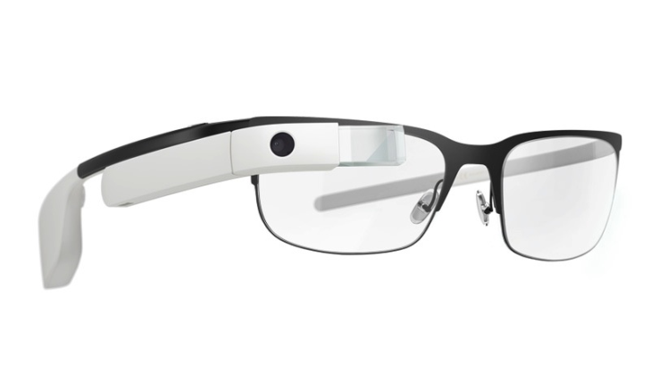
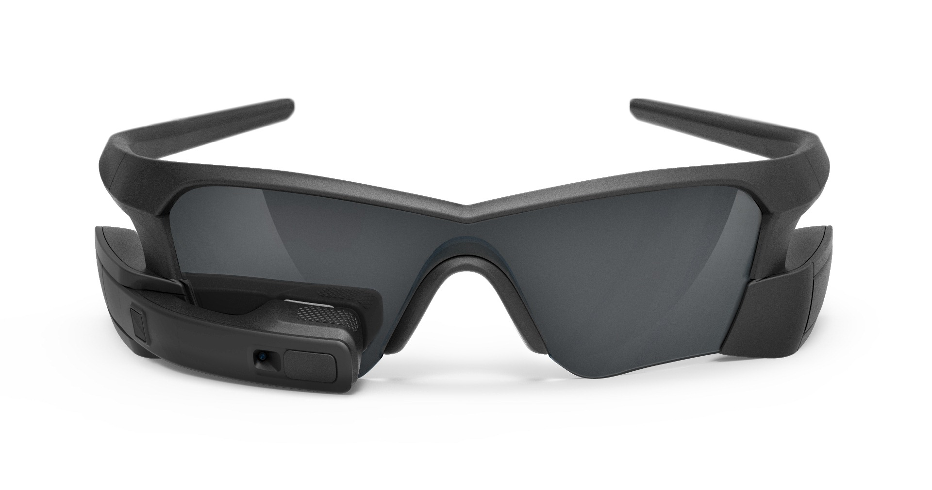
Requirements for Data Collection System
Inclusive wrt. sensors
Widely available platform
Unobtrusive

Slide 10
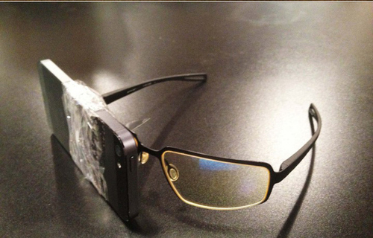
Smartphone as a Data-Collecting Front-end

Slide 11
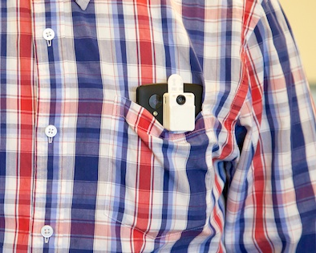
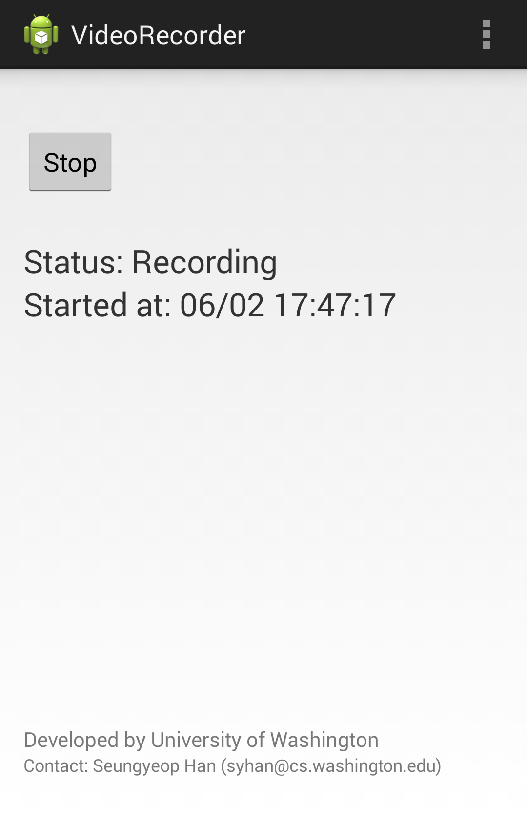

Smartphone as a Data-Collecting Front-end
Camera
Audio
Location
Sensors
Thermal
Camera
Android application
Running as a service
~5 video frame per second
Sync with timestamps
Collect all possible sensors
Custom-built
16x4 temp array
40x15◦ FOV

Slide 12
Collected Dataset
Total 116 minutes over 7 days
~1M Sensor readings
~100k Thermal camera frames
>30k RGB frames (~5% are face frames)

Slide 13
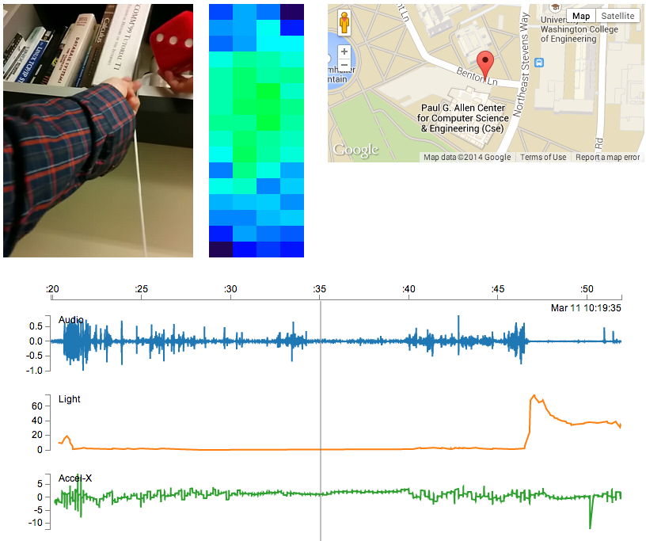
[demo] Visualization
JS visualizer running on browsers.

Slide 14
GlimpseData
Data collection and analysis framework to study continuous sensor-augmented visual data
Case study on predicting whether a frame contains faces

Slide 15
Case Study: Filtering Non-Face Frames with Low Data-rate Sensors
Build classifier determining non-face frames.
Test with OpenCV face detector, and manually inspect frames.
Goal: filter out as many frames as possible while not missing frames with faces

Slide 16
Not All Frames Have Faces
less than 5% frames contain faces in the data
Input Visual Stream
Does the frame have faces?
Filter
Low-power sensor data
Accelerometer,
Gyroscope, Light,
Sound, Location,
Thermal Sensor
YES
Can we determine if a frame is unlikely to have a face
before running face detector?

Slide 17
Thresholding on Single Sensor
Applying a threshold on each sensor value is promising

Slide 18


Thresholding on Single Sensor
Note: Face detector is resilient to noise
Applying a threshold on each sensor value is promising

Slide 19
Joint Classifier
With a logistic regressor using all sensors, it can filter out 60% of frames
while missing only 10% frames with faces.

Slide 20
Discussion
How to contribute data for the research community
Need data with better quality (e.g., synchronization is an issue)
Privacy concerns with sharing data
Beyond filtering
Design APIs for multiple applications
Need better classification methods

Slide 21
Summary
Visual data is extremely rich and could be useful and continuous analysis may be feasible.
But, collecting large, rich dataset is challenging.
We presented GlimpseData, a data collection and analysis framework.
A case study showed promising results for filtering uninteresting frames and feasibility of such study.

Slide 22
Q&A
https://github.com/UWNetworksLab/GlimpseData

